Slide 1
Data-backed Pricing Strategy
A pricing methodology to reflect Big Mountain Resort’s competitive amenities

Slide 2
Problem Identification
Current, non-data-backed, pricing = $81
Is $81 competitive given amenities / features compared to other resorts?
Need a model to assess impact of proposed resort changes on ticket price

Slide 3
Key Findings & Recommendation
Resort features that impact pricing the most are the following:
Size of vertical drop
Number of fast quads
Number of runs
Number of chairs
Given Big Mountain’s competitive position in these areas, an increase in ticket pricing from $81 to $89 is recommended

Slide 4
Modeling - Strategy & Result
Strategy - Principal Component Analysis
Result - Pricing & Location Relationship
Conduct a Principal Component Analysis to identify whether there is a clustering of ticket pricing based on location
No connection is found between location and ticket prices
All resorts can be used in subsequent modeling

Slide 5
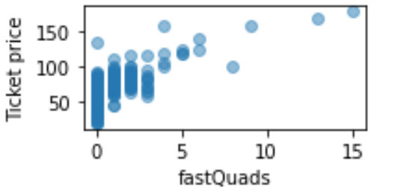
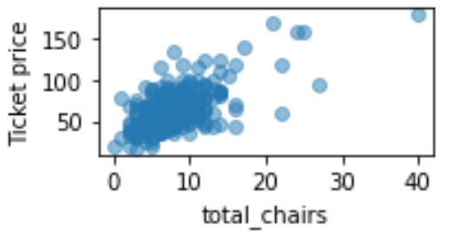
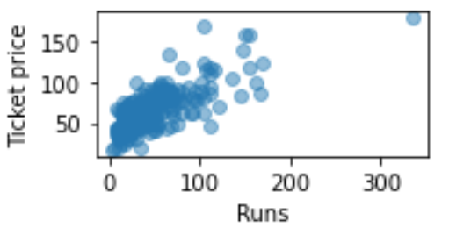
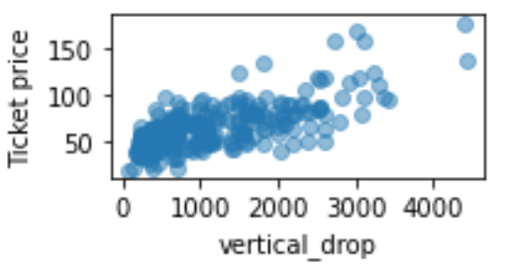
Modeling - Strategy & Result
Strategy - Correlation Tests
Result: Most Impactful Features
Conduct a correlation test between ticket price and each resort feature to determine which feature impacts pricing the most
Size of vertical drop, number of chairs, number of runs, number of fast quads

Slide 6
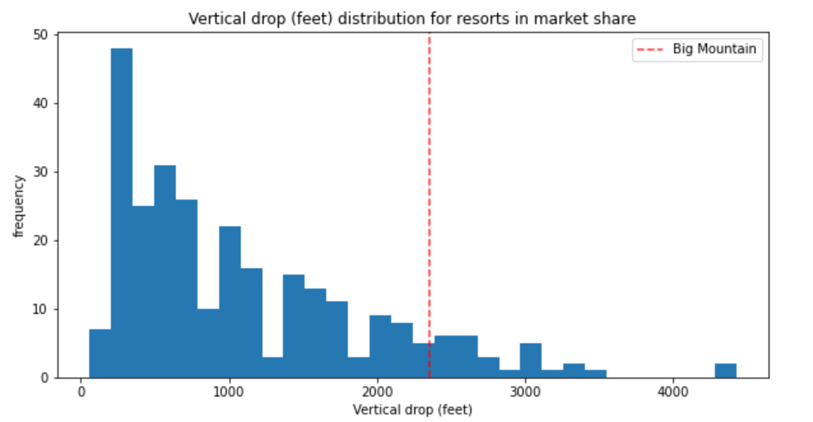
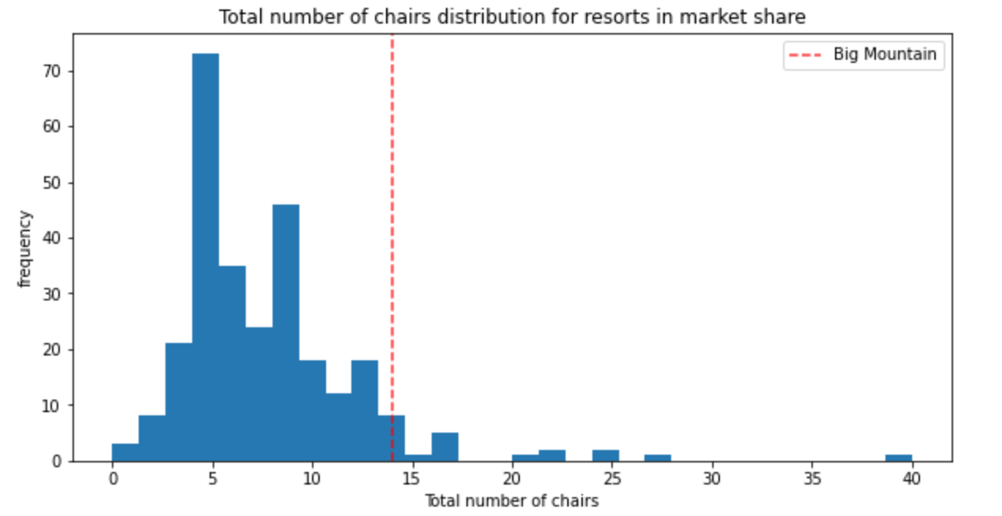
Modeling - Strategy & Result
Strategy - Identify Market Position
Result: Competitive Position
Compare Big Mountain’s most impactful features against the entire market to identify Big Mountain’s market position
Big Mountain is found to be in a very competitive market position

Slide 7
Modeling - Strategy & Result
Strategy - Use Price Model To Assess Future Changes
Result: Proposed Changes’ Impact on Pricing
Assess cost-cutting scenarios:
1) Close runs
2) Add a run, increase the vertical drop by 150 feet, and install an additional chair lift
3) Add 2 acres of snow making
4) Extend the longest run by 0.2 miles and snow coverage by adding 4 acres
Sharp drop in revenue noted only after closing 6 runs
Scenario 2 allows for $2.39 increase in ticket price ($4MM over season)
Scenario 3 and 4 led to no added benefits in ticket price

Slide 8
Summary & Conclusion
Given Big Mountain’s competitive position in these areas, an increase in ticket pricing from $81 to $89 is recommended
Upto 5 runs can be closed without a noticeable decrease in revenue
Adding a run, increasing the vertical drop by 150 feet, and installing an additional chair lift leads to >$4MM revenue gain over a skiing season
Adding 2 acres of snow making or extending the longest run by 0.2 miles and snow coverage by 4 acres will not lead to any financial benefit

